Slide 1
Deutsch-Jozsa Algorithm
By Aaron Baxter

Slide 2
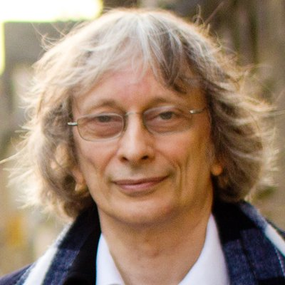
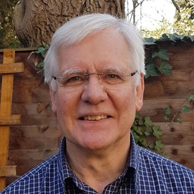
Who is?
David Deutsch
Richard Jozsa

Slide 3
Deutsch:
Born in Haifa, Israel
University of Oxford
Centre for Quantum Computation
Micius Quantum Prize (2018)
Fellow of the Royal Society (2008)
Jozsa:
Born in Australia
University of Cambridge
Founder of Quantum Teleportation
Fellow of the Royal Society (2019)

Slide 4
The Algorithm
- The function where n ∈ Z⁺:
f: {0,1}^{n}
{0,1}
We are promised that:
The function is either constant or balanced

Slide 5
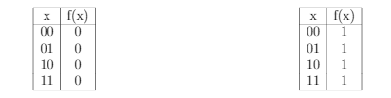
Constant Function
-F is a constant function if and only if f(x) = 0 for every x∈{0,1}^{n} or f(x) = 1 for every x∈{0,1}^{n}. For example:

Slide 6
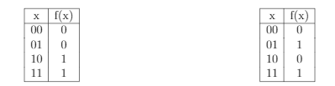
Balanced Function
-F is a balanced function if and only if f(x) = 0 for half of all x∈{0,1}^{n} and f(x) = 1 for half of all x∈{0,1}^{n}. For example:

Slide 7

Classical Runtime
- How long will the program take to run on a classical computer?
- Let’s do an example with 2 qubits (4 bits).
- Can we tell what function this is?

Slide 8


Cont’d
- We would need to know the 3rd bit’s output to determine the function:
- Worst case scenario for classical computer: 2^{n-1}+1
- Quantum computing can accomplish this in 1 step
Constant
Balanced

Slide 9

The Circuit

Slide 10
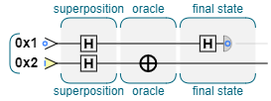
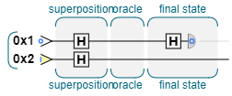


What’s in the Oracle?
- Constant function:

Slide 11
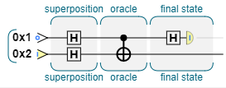



What’s in the Oracle?
- Balanced function:

Slide 12
What does the READ gate tell us?
- What is read:
±|f(0) ⊕ f(1)>

Slide 13
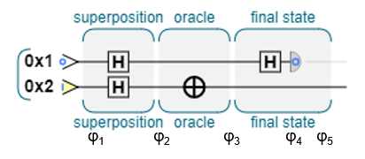
Example

Slide 14
Step 1
Represent |10> in vector form

Slide 15
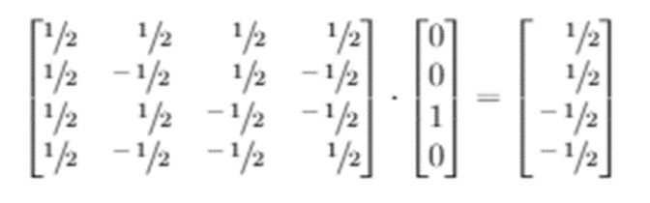
Step 2
Apply Hadamard gate to register

Slide 16

Step 3
Apply Oracle function to resulting matrix

Slide 17

Step 4
Apply I₂ ⊗ H to resulting matrix

Slide 18

Step 5
Read 0x1

